Slide 1
Rain Prediction using ANN
Group F

Slide 2
Contents Of This Template
Here’s what you’ll find in this Slidesgo template:
A slide structure based on a Marketing Plan presentation, which you can easily adapt to your needs. For more info on how to edit the template, please visit Slidesgo School or read our FAQs.
An assortment of graphic resources that are suitable for use in the presentation can be found in the alternative resources slide.
A thanks slide, which you must keep so that proper credits for our design are given.
A resources slide, where you’ll find links to all the elements used in the template.
Instructions for use.
Final slides with:
The fonts and colors used in the template.
A selection of illustrations. You can also customize and animate them as you wish with the online editor. Visit Storyset to find more.
More infographic resources, whose size and color can be edited.
Sets of customizable icons of the following themes: general, business, avatar, creative process, education, help & support, medical, nature, performing arts, SEO & marketing, and teamwork.
You can delete this slide when you’re done editing the presentation.

Slide 3
Table of contents
01
02
03
04
About Us
Introduction
Detail Software
Python
Goals & Strategy
Detail on AiI Project Management
Goals & Strategy
Flow, algorithm and problem solving
Conclusion

Slide 4
Introduction
01
Background and Case Study

Slide 5
Background
4. Cutting-edge Technology:
Exploration of Artificial Neural Networks (ANNs).
5. Role of ANNs:
Addressing complexities in climate patterns.
Enhancing precision in localized forecasts.
6. Industries Benefiting:
Water resource management.
Emergency preparedness.
Importance of Rain Forecasting:
Vital for urban planning, agriculture, water management, and emergencies.
Traditional Forecasting Tools:
Relies on meteorological data and statistical models.
Challenges Driving Innovation:
Growing complexity of climate patterns.
Need for accurate, localized forecasts.

Slide 6
Case Study
1. Role of ANNs in Rainfall Prediction:
ANNs and machine learning enhance precision in rainfall prediction models.
2. Limitations of Conventional Models:
Traditional models struggle with nonlinear and dynamic weather patterns.
Difficulty representing complex correlations in large datasets.
3. Strength of ANNs:
Well-suited for weather prediction due to their ability to learn intricate patterns.
Inspired by the neural structure of the human brain.
4. Project Focus:
Case study on creating and deploying an ANN-based rain forecast model.
5. Training Approach:
Training the ANN on historical weather data to understand complex patterns and connections.
6. Outcome Expectation:
Enhanced ability to provide well-informed rainfall predictions in specific geographic locations and time frames.

Slide 7
Detail Software
02
Python

Slide 8
Python Libraries
NumPy and Pandas:
NumPy: Essential for numerical operations, providing support for large, multi-dimensional arrays and matrices.
Pandas: Ideal for data manipulation and analysis, facilitating the preprocessing of weather datasets.
Scikit-Learn:
Offer tools for ML, including modules for data preprocessing, model training, and evaluation. For rain prediction, algorithms like NN are available in the neural_network module.
TensorFlow or PyTorch:
For implementing neural networks, DL frameworks such as TensorFlow or PyTorch are used. These frameworks offer high-level APIs for building and training complex NN architectures.
Matplotlib and Seaborn:
These libraries aid in data visualization, allowing for the graphs to interpret model performance and predictions.

Slide 9
Implementation Step
Data Collection and Preprocessing:
Acquire historical weather data containing features like temperature, humidity, wind speed, and atmospheric pressure.
Use Pandas for data cleaning, handling missing values, and organizing the dataset.
Feature Engineering:
Identify relevant features that influence rainfall predictions.
Use NumPy and Pandas for creating new features or transforming existing ones.
Model Development with ANN:
Choose TensorFlow or PyTorch to build the neural network architecture.
Define the input layer, hidden layers, and output layer, specifying activation functions and other hyperparameters.

Slide 10
4. Training and Evaluation:
Utilize Scikit-Learn for splitting the dataset into training and testing sets.
Train the ANN on historical data and evaluate its performance using metrics such as accuracy, precision, recall, and F1 score.
5. Visualization:
Use Matplotlib and Seaborn to visualize the model's predictions against actual rainfall data.
Create plots to illustrate the learning curve, convergence, and model evaluation.

Slide 11
Detail on AI Project Management
03

Slide 12
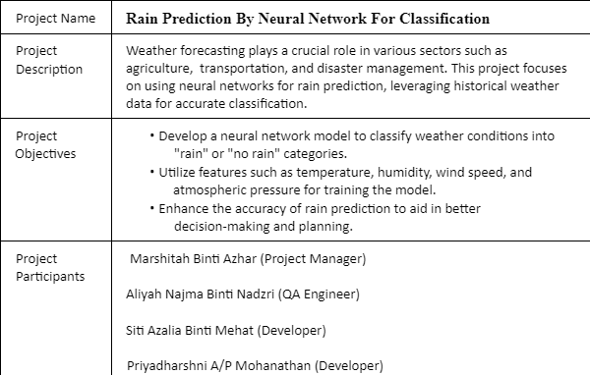
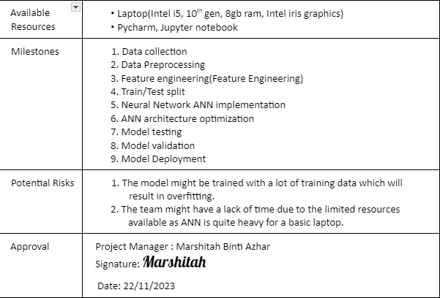
Project Charter

Slide 13
Planning
Project Timeline:
Phase 1: Planning (1-2 months)
Identify the project stakeholders and their needs.
Define the scope of the project and develop a project plan.
Gather and prepare the data that will be used to train and evaluate the ANN model.
Phase 2: Model development (2-4 months)
Develop the ANN model architecture.
Train the ANN model on the prepared data.
Evaluate the performance of the ANN model on a held-out test set.
Phase 3: Software development (2-3 months)
Develop a software application that implements the ANN model.
Test the software application to ensure that it is working as expected.

Slide 14
Phase 4: Deployment and training (1-2 months)
Deploy the software application to the end users.
Train the end users on how to use the software application and the rain prediction model.
Phase 5: Maintenance and support (ongoing)
Monitor the performance of the rain prediction model.
Provide support to the end users.
The total project timeline could range from 6 to 12 months, depending on the complexity of the project.

Slide 15
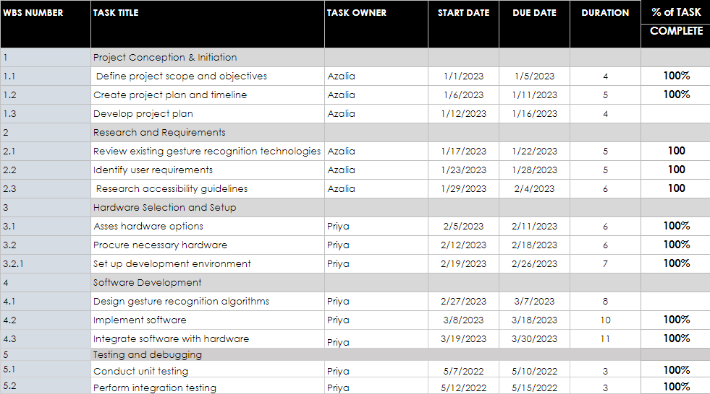
Work Breakdown Structure

Slide 16
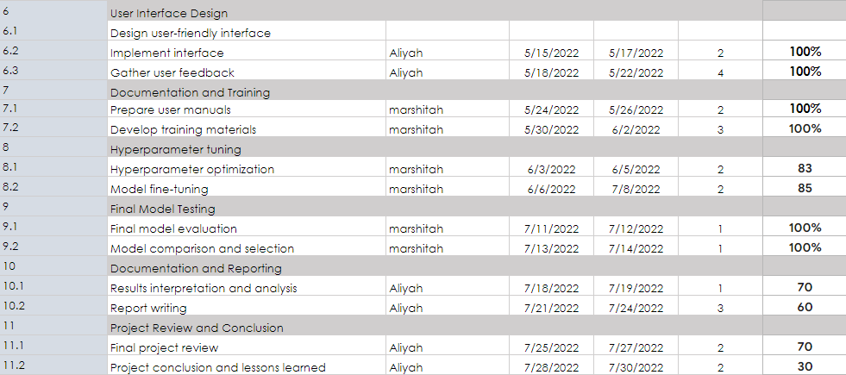
Work Breakdown Structure

Slide 17
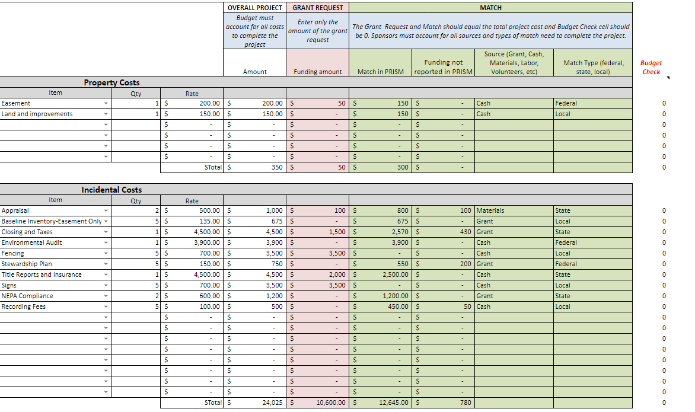
Cost Estimation Acquisition

Slide 18
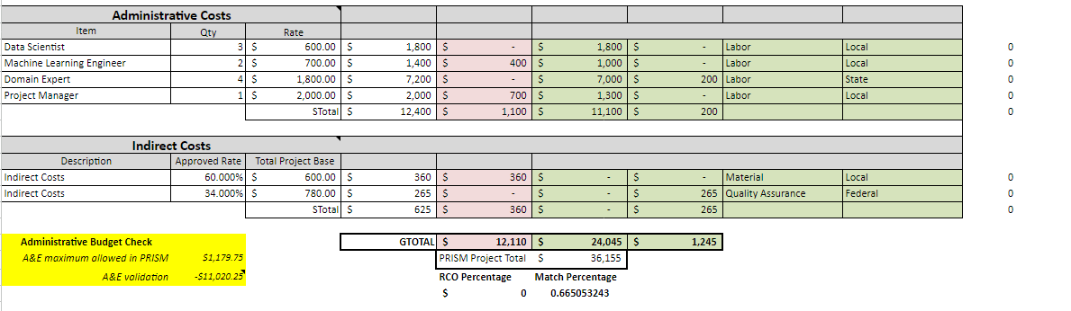
Cost Estimation

Slide 19
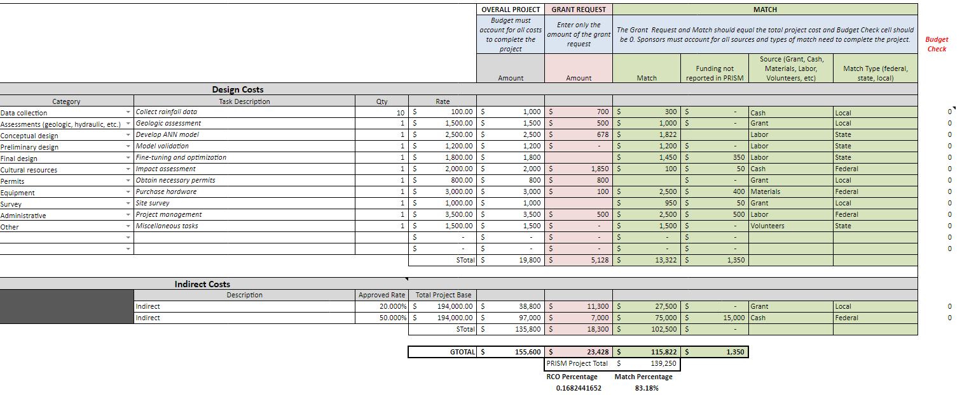
Cost Estimation Design Project

Slide 20
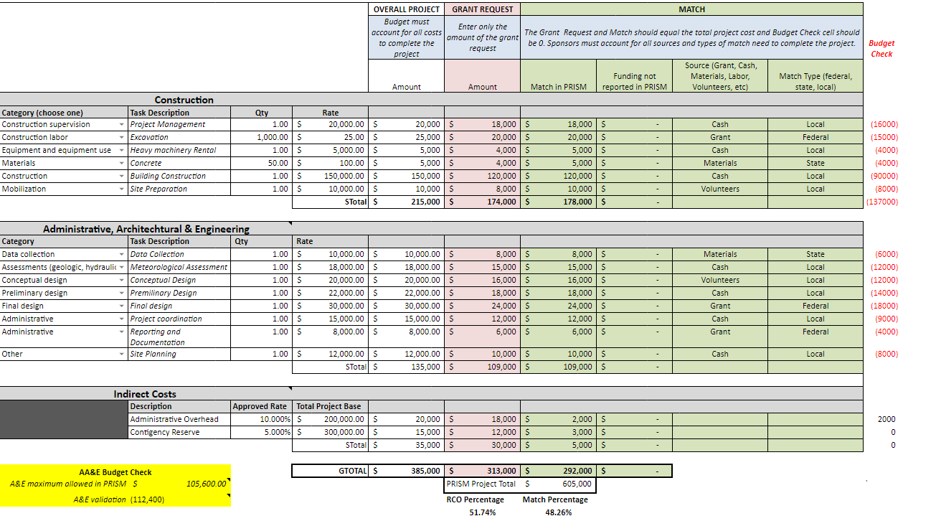
Cost Estimation Restoration

Slide 21
Flow, Algorithm & Problem Solving
04

Slide 22
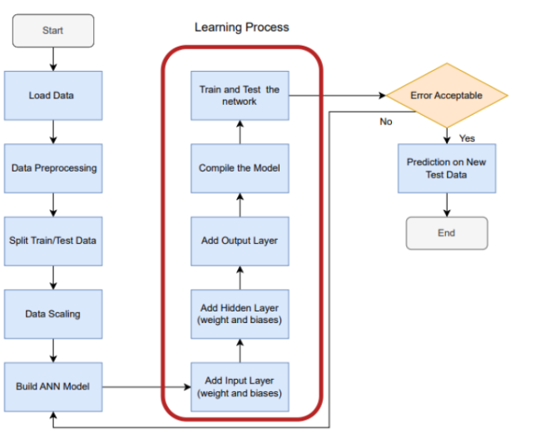
Flow

Slide 23
Algorithm
Load Data
Data Scaling
Load the data from the dataset
Input features are on similar scale, preventing certain features from dominating others during training process.
Data Preprocessing
Build ANN Model
Gather historical weather data, including variables such as temperature.
Building an effective ANN model involves an iterative process of experimentation and refinement to achieve desired level of accuracy
Split train/Test Data
Learning Process
Divide the dataset into training, validation and testing sets.
Involves the adaptation and improvement of the model’s performance over time based on the available data

Slide 24
Problem Solving
Data Quality:
Problem: Inaccurate or incomplete historical weather data can lead to poor model performance.
Solution: Carefully preprocess and clean the data, handling missing values and outliers
Continuous Learning:
Problem: Weather patterns change over time, and a model trained on historical data may become less accurate over the long term.
Solution: Implement a continuous learning approach by regularly updating the model with new data.
Data Imbalance:
Problem: Imbalanced datasets, where one class (rainy or non-rainy) is significantly more prevalent, can bias the model.
Solution: Balance the dataset through techniques such as oversampling the minority class or undersampling the majority class.

Slide 25
Project Implementation & Output
05

Slide 26
Implementation
The dataset about 10 years of daily weather observations
Importing the dataset
Data visualization refers to the graphical representations of data and information.
Data visualization and cleaning
Data Preprocessing
This section detects outliers and features data, remove the outliers based on specific filtering conditions and provides visualizations
The purpose is to build an artificial neural network.
Model Building

Slide 27
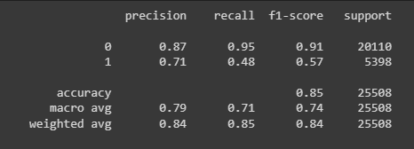
Output

Slide 28
Monitoring and Controlling
07
Project Detail Review
Change Request Form
Updated Work Breakdown Structure

Slide 29
Scope Statement
Scope:
The scope for rain prediction using ANN projects is broad and includes a variety of potential applications, such as:
Agriculture: Farmers can use ANN-based rainfall prediction models to make informed decisions about planting, irrigation, and harvesting.
Water resource management: Water managers can use ANN-based rainfall prediction models to optimize reservoir operations and flood forecasting.
Disaster management: Emergency responders can use ANN-based rainfall prediction models to prepare for and respond to floods, landslides, and other weather-related disasters.
Insurance: Insurance companies can use ANN-based rainfall prediction models to assess risk and set premiums.

Slide 30
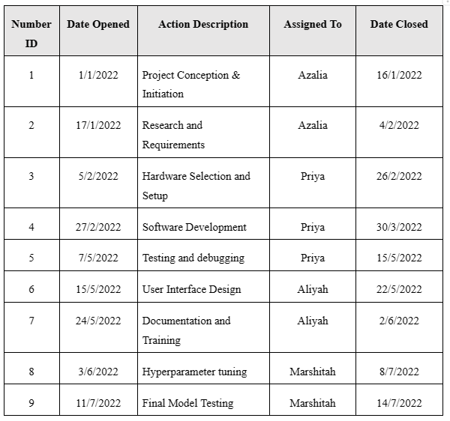
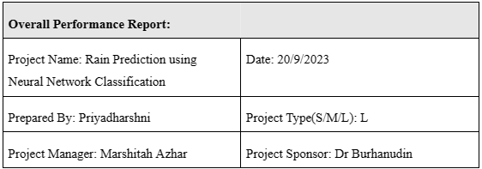
Project Detail Review

Slide 31
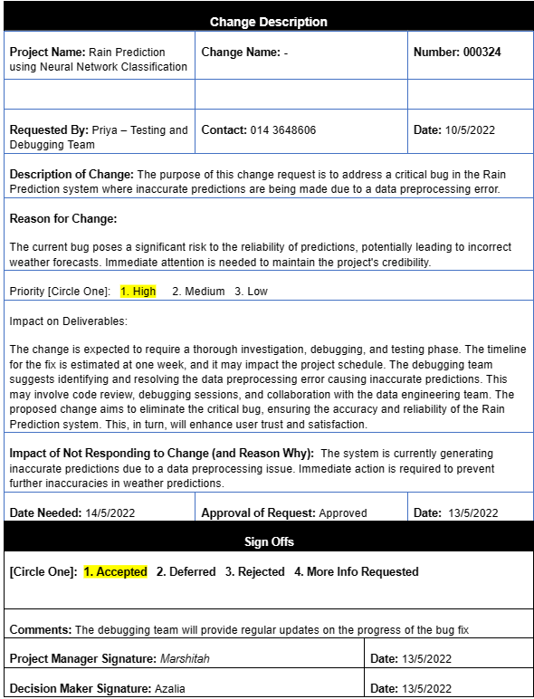
Change Request Form
A change was request as the prediction system where inaccurate predictions are being made due to a data preprocessing error

Slide 32
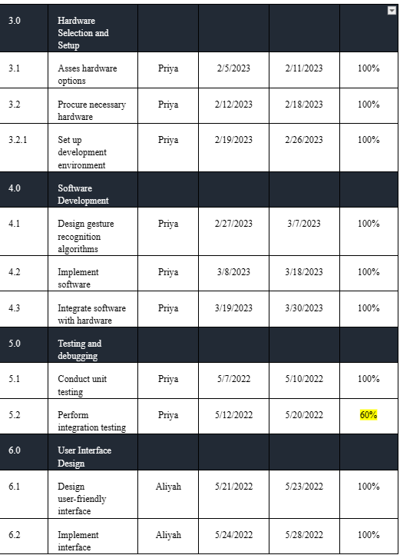
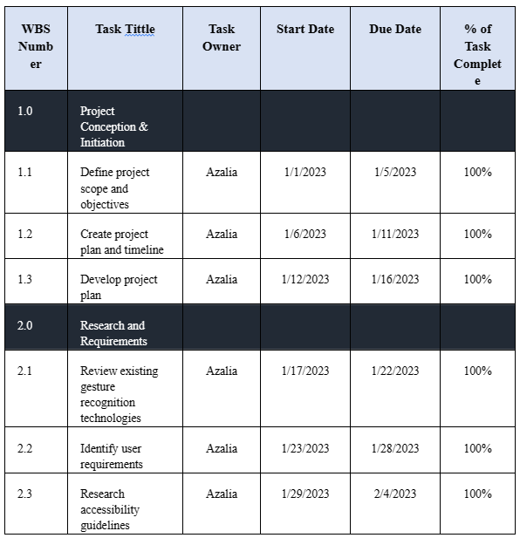
Updated Work Breakdown Structure

Slide 33
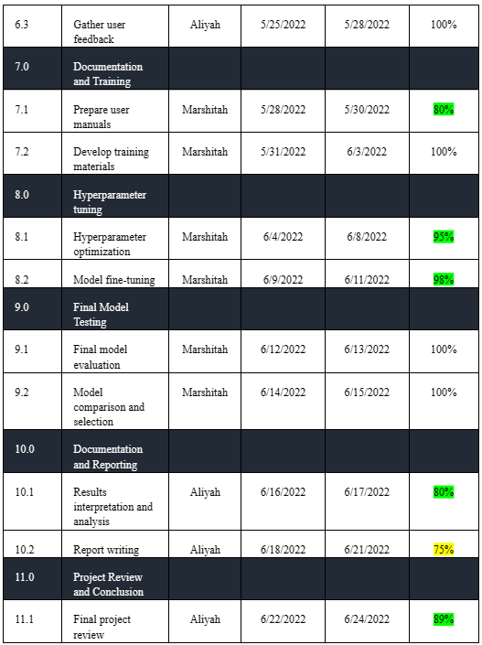

Updated Work Breakdown Structure

Slide 34
Closing Process
Lesson Learn
Lesson 1: The model might be trained with a lot of training data which will result in overfitting.
Recommandation: Ensure that the model is trained with an appropriate amount of data.
Lesson 2: The team might have a lack of time due to the limited resources available as ANN is quite heavy for a basic laptop.
Recommandation: Use cloud-based solutions to reduce the computational burden on local hardware.

Slide 35
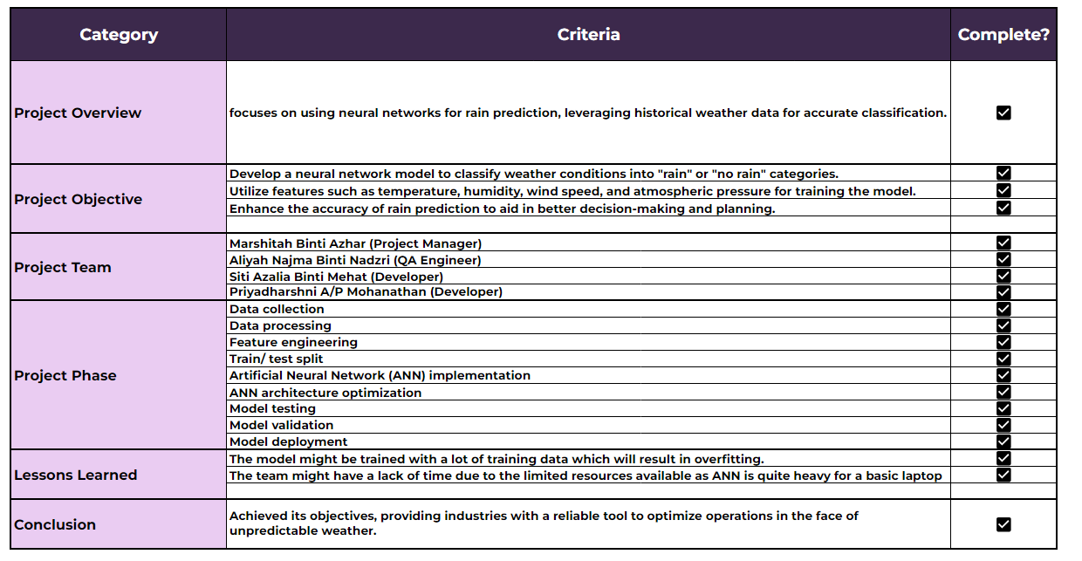
Closing Process
Project archive

Slide 36
Conclusion
09

Slide 37
Traditional weather forecasting methods, while valuable, often struggle with the intricate and dynamic nature of climate patterns
This has created a demand for more accurate and localized predictions, leading researchers towards innovative solutions like Artificial Neural Networks (ANNs).
This advancement promises to benefit diverse sectors and communities, ultimately contributing to a more informed and resilient future in the face of complex climate patterns.

